Slide 1
Part-Of-Speech Tagging
Radhika Mamidi

Slide 2
POS tagging
Tagging means automatic assignment of descriptors, or tags, to input tokens.
Example:
“Computational linguistics is an interdisciplinary field dealing with the statistical and logical modeling of natural language from a computational perspective.”

Slide 3
Output
Computational_AJ0 linguistics_NN1 is_VBZ an_AT0 interdisciplinary_AJ0 field_NN1 dealing_VVG with_PRP the_AT0 statistical_AJ0 and_CJC logical_AJ0 modeling_NN1 of_PRF natural_AJ0 language_NN1 from_PRP a_AT0 computational_AJ0 perspective_NN1 ._.
[using CLAWS pos tagger]

Slide 4
Ambiguity
Book – verb/noun
Close – verb/adjective
To – preposition/infinitive
Fast – adjective/adverb/verb

Slide 5
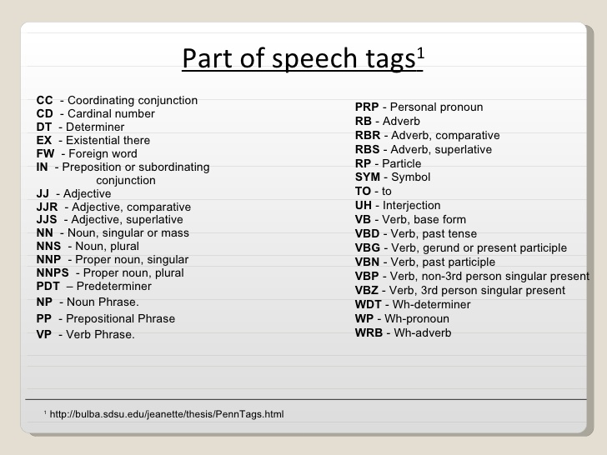
WP$-Possesive wh pronoun
MD-Modals

Slide 6
Applications
Used as preprocessor for several NLP applications [Machine Translation, HCI…]
For information technology applications [text indexing, retrieval…]
To tag large corpora which will be used as data for linguistic study [BNC,..]
Speech processing [pronunciation,..]

Slide 7
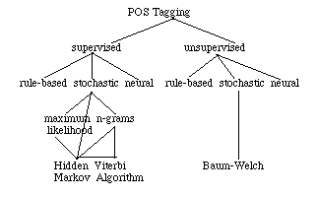
Approaches

Slide 8
Supervised taggers
Supervised taggers typically rely on pre-tagged corpora to serve as the basis for creating any tools to be used throughout the tagging process.
For example: the tagger dictionary, the word/tag frequencies, the tag sequence probabilities and/or the rule set.

Slide 9
Unsupervised taggers
Unsupervised models are those which do not require a pretagged corpus
They use sophisticated computational methods to automatically induce word groupings (i.e. tag sets)
Based on those automatic groupings, the probabilistic information needed by stochastic taggers is calculated or the context rules needed by rule-based systems is induced.

Slide 10
SUPERVISED | UNSUPERVISED
selection of tagset/tagged corpus | induction of tagset using untagged training data
creation of dictionaries using tagged corpus | induction of dictionary using training data
calculation of disambiguation tools. may include: | induction of disambiguation tools. may include:
word frequencies | word frequencies
affix frequencies | affix frequencies
tag sequence probabilities | tag sequence probabilities
"formulaic" expressions
tagging of test data using dictionary information | tagging of test data using induced dictionaries
disambiguation using statistical, hybrid or rule based approaches | disambiguation using statistical, hybrid or rule based approaches
calculation of tagger accuracy | calculation of tagger accuracy

Slide 11
Rule based approach
Rule based approaches use contextual information to assign tags to unknown or ambiguous words.
These rules are often known as context frame rules.
Example,
  If an ambiguous/unknown word X is preceded by a determiner and followed by a noun, tag it as an adjective.
  det - X - n = X/adj

Slide 12
STOCHASTIC TAGGING
Any model which somehow incorporates frequency or probability, i.e. statistics, may be properly labeled stochastic.

Slide 13
a. Word frequency measurements
The simplest stochastic taggers disambiguate words based solely on the probability that a word occurs with a particular tag.
The problem with this approach is that while it may yield a valid tag for a given word, it can also yield inadmissible sequences of tags.

Slide 14
b. Tag sequence probability
The probability of a given sequence of tags occurring is calculated using the n-gram approach
It refers to the fact that the best tag for a given word is determined by the probability that it occurs with the n previous tags.
The most common algorithm for implementing an n-gram approach is known as the Viterbi Algorithm.
It is a search algorithm which avoids the polynomial expansion of a breadth first search by "trimming" the search tree at each level using the best N Maximum Likelihood Estimates (where n represents the number of tags of the following word).

Slide 15
Hidden Markov Model
It combines the previous two approaches –i.e. it uses both tag sequence probabilities and word frequency measurements
HMM's cannot, however, be used in an automated tagging schema, since they rely critically upon the calculation of statistics on output sequences (tagstates).

Slide 16
Baum-Welch Algorithm
The solution to the problem of being unable to automatically train HMMs is to employ the Baum-Welch Algorithm, also known as the Forward-Backward Algorithm.
This algorithm uses word rather than tag information to iteratively construct a sequences to improve the probability of the training data.

Slide 17
Refer
https://repository.upenn.edu/cgi/viewcontent.cgi?article=1603&context=cis_reports
Chapter 11
The Oxford Handbook of Computational Linguistics
POS tagging demo:
CLAWS (the Constituent Likelihood Automatic Word-tagging System) tagger
http://www.comp.lancs.ac.uk/ucrel/claws/trial.html

